Slide 1
Overview of iOS, Xcode, and Swift
전 흥 석
건국대학교 컴퓨터공학과

Slide 2
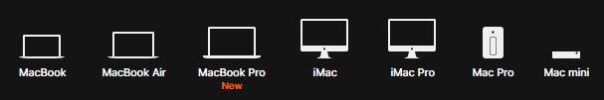

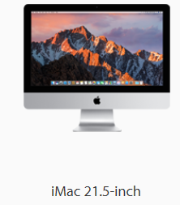
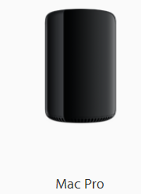
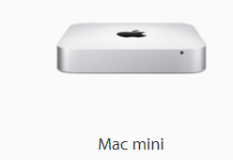
Macintosh

Slide 3
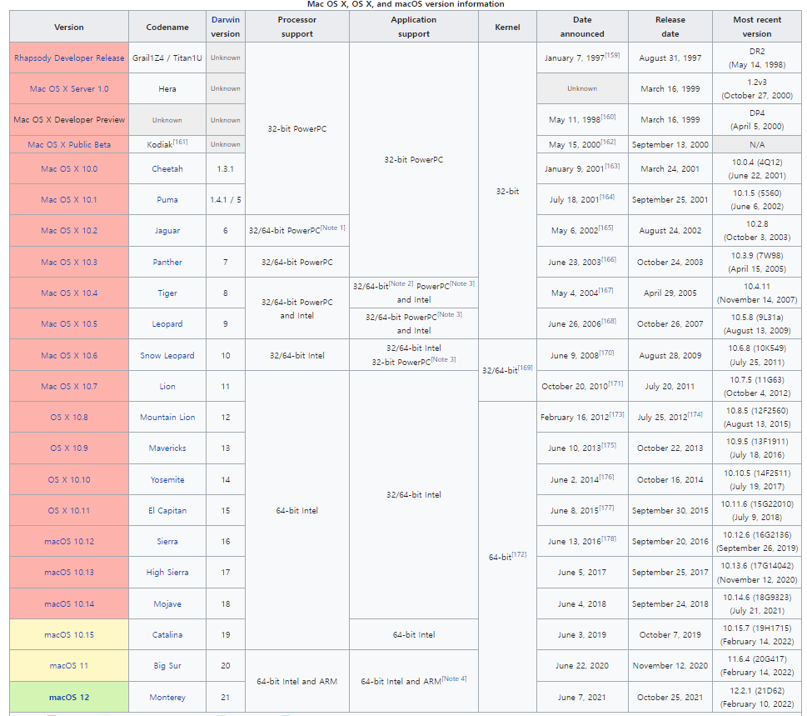
Mac OS

Slide 4
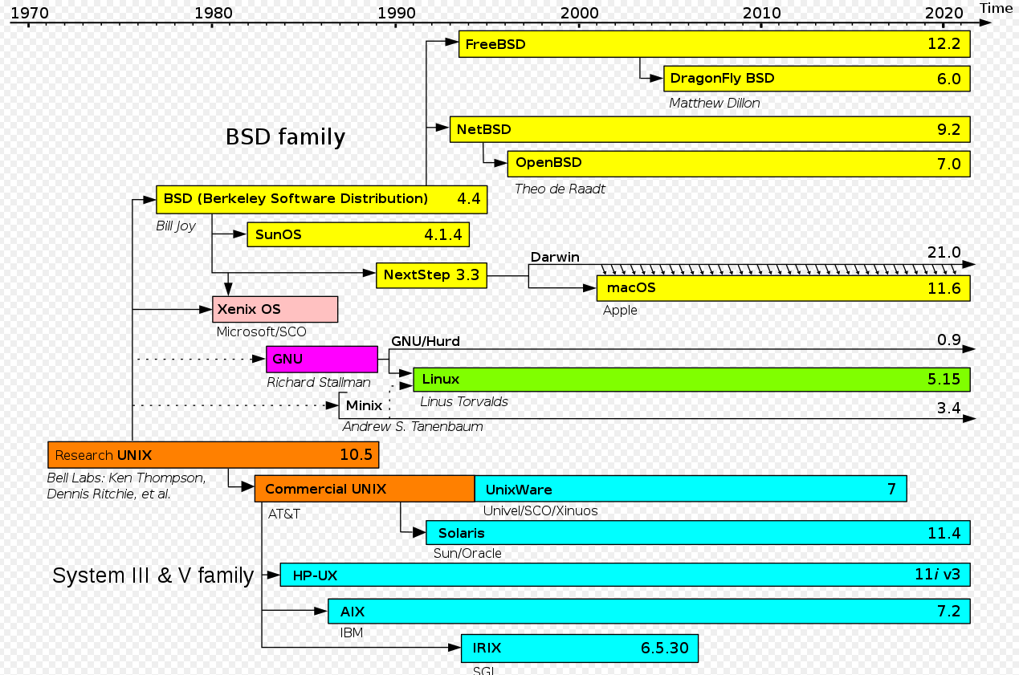
Mac OS history

Slide 5
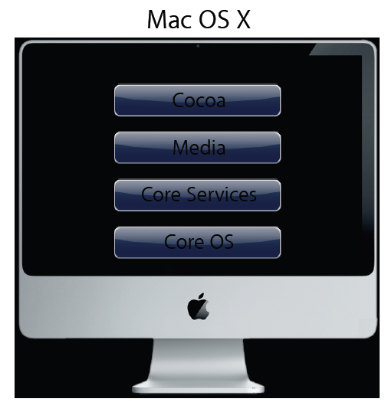

Slide 6
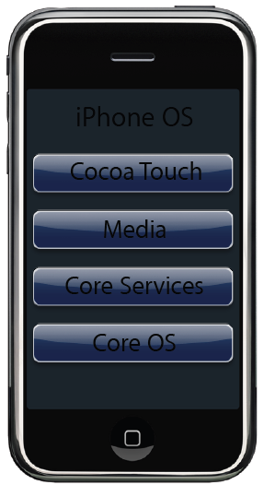

Slide 7
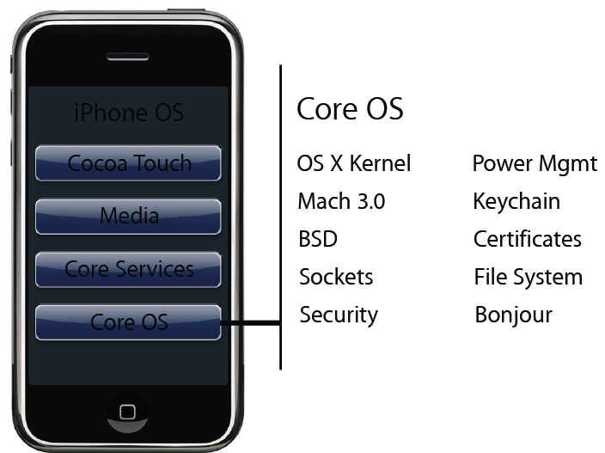
Core OS

Slide 8
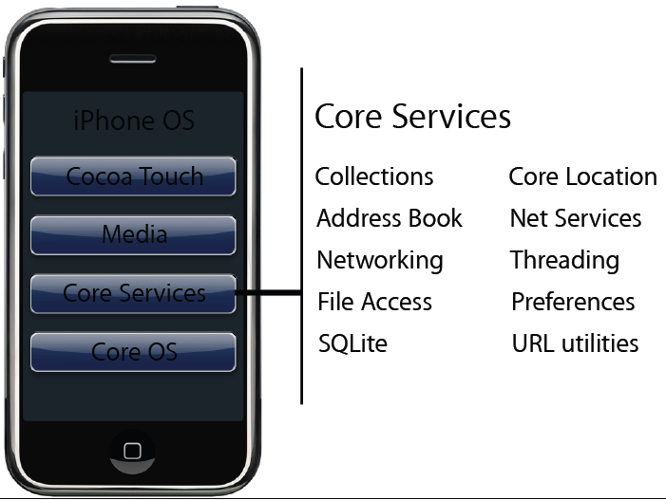
Core Services

Slide 9
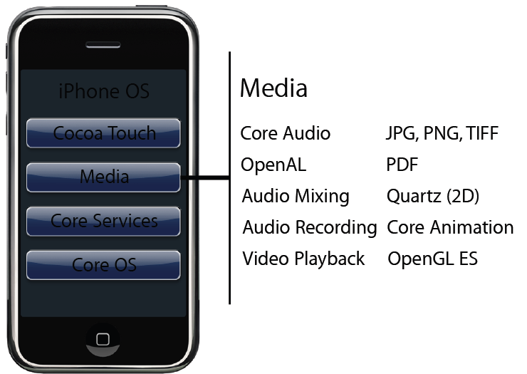
Media

Slide 10
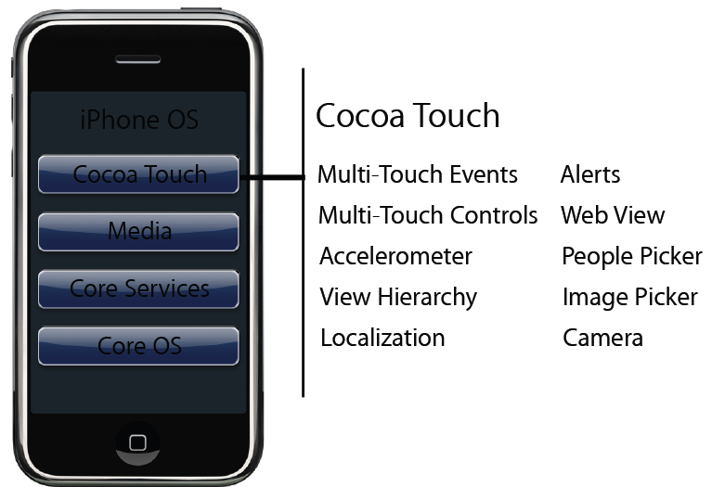
Cocoa Touch

Slide 11
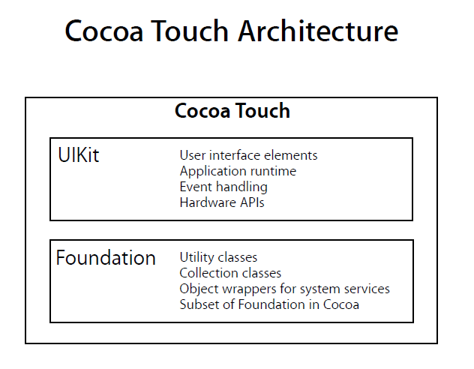

Slide 12
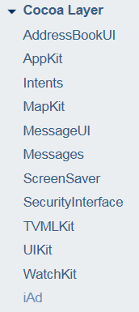
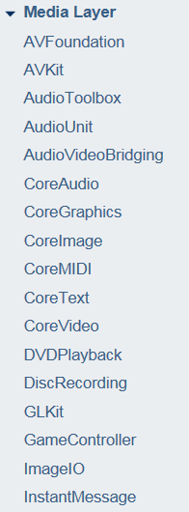
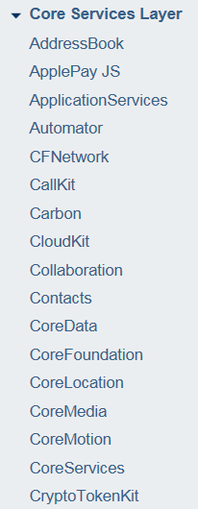
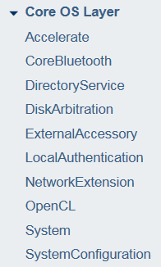

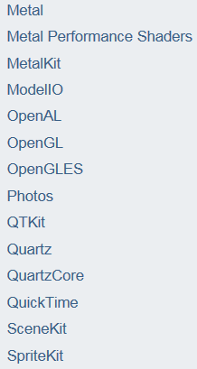
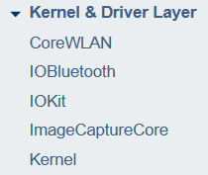


Slide 13
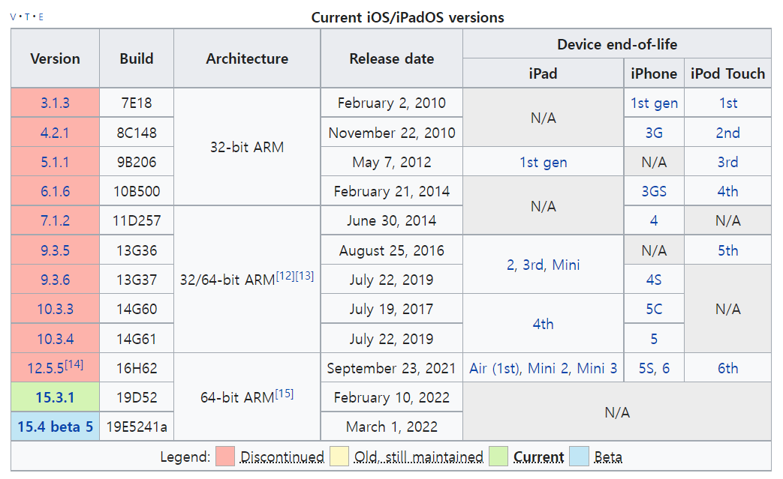
iOS versions

Slide 14
iOS의 역사
iPhone OS
2007년 맥월드 컨퍼런스
iPhone OS 2
2008년 3월
iPhone OS 3
2009년 6월
한국출시 아이폰 3GS 탑재
iOS 4
2010년 6월
아이패드 출시 고려 명칭 변경
멀티태스킹 지원
FaceTime 도입

Slide 15
iOS 5
2011년 6월
iCloud
iMessage
ARC (Automatic Reference Counting) 도입
iOS 6
2012년 6월
Siri의 한국어지원
iOS 7
2013년 6월
전체적인 UI 변경

Slide 16

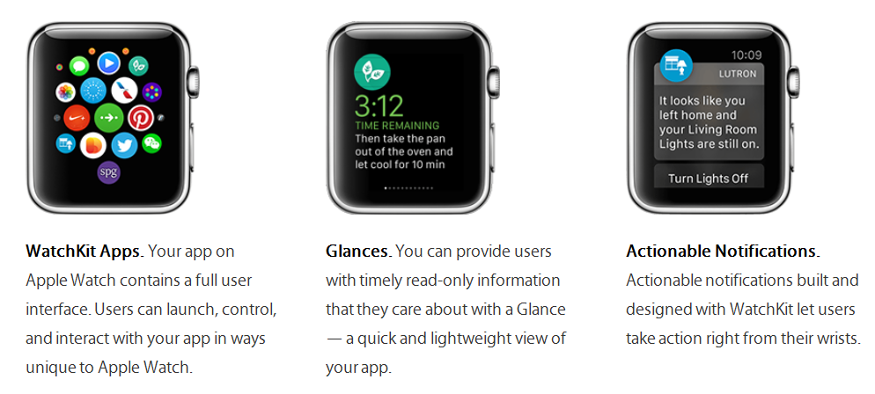
iOS 8
WatchKit
Two parts
A WatchKit extension that runs on iPhone (runs in background)
A set of user interface resources that are installed on Apple Watch

Slide 17


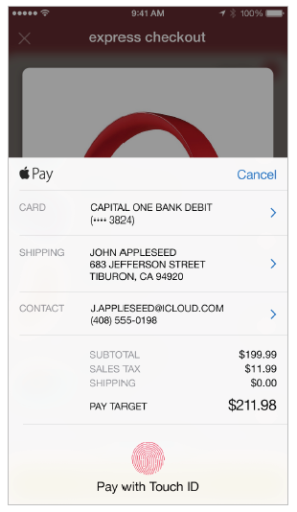

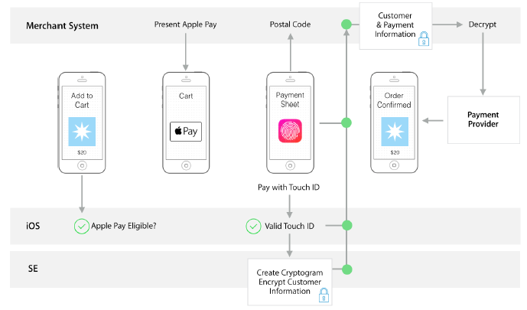
iOS 8
App Extensions
Touch ID
Authentication
Fingerprint data is protected and never accessed by iOS or other apps.
Apple pay with a single touch
Apple Pay
Use Touch ID for payment

Slide 18






iOS 8
PhotoKit
Manual Camera Controls
HealthKit
A user’s health information is stored in a centralized
HomeKit
For communicating with and controlling connected accessories in home
Discover, configure, and control
CloudKit
Handoff
Users start an activity on one device and seamlessly resume the activity on another device
Save, transfer, and restore
Swift 등장 with Xcode 6

Slide 19
iOS 9
Multitasking Enhancements for iPad
3D Touch
Search
Gaming
App Thinning
Support for Right-to-Left Languages
App Transport Security
Extension Points
Contacts and Contacts UI
Watch Connectivity
Keychain
Swift Enhancements (Xcode 7, Swift 2)

Slide 20
iOS 10
Providing Haptic Feedback
SiriKit
Proactive Suggestions
Integrating with the Messages App
User Notifications
Speech Recognition
Wide Color
Adapting to the True Tone Display
App Search Enhancements
Widget Enhancements
Apple Pay Enhancements
Security and Privacy Enhancements
CallKit
News Publisher Enhancements
Video Subscriber Account
App Extensions
Swift Enhancements (Xcode 8, Swift 3)

Slide 21
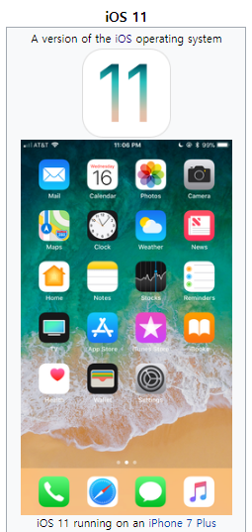
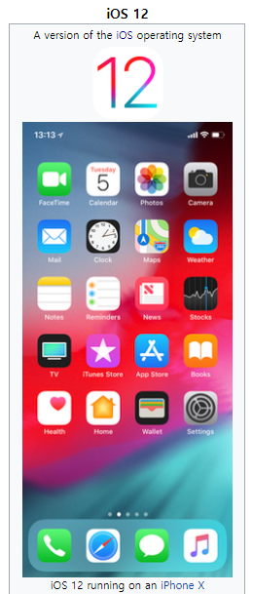
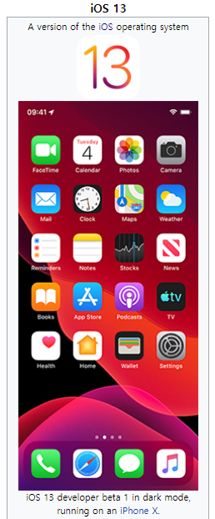
iOS 11, 12, and 13
2017
2018
2019
(Xcode 9, Swift 4)
(Xcode 10, Swift 4.2)
(Xcode 11, Swift 5.1)

Slide 22
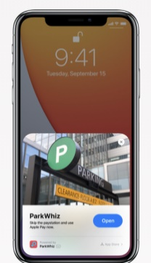
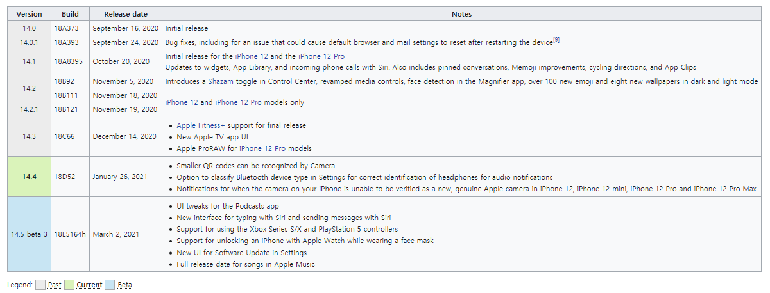

iOS 14
2020 - 2021
(Xcode 12, Swift 5.4)

Slide 23
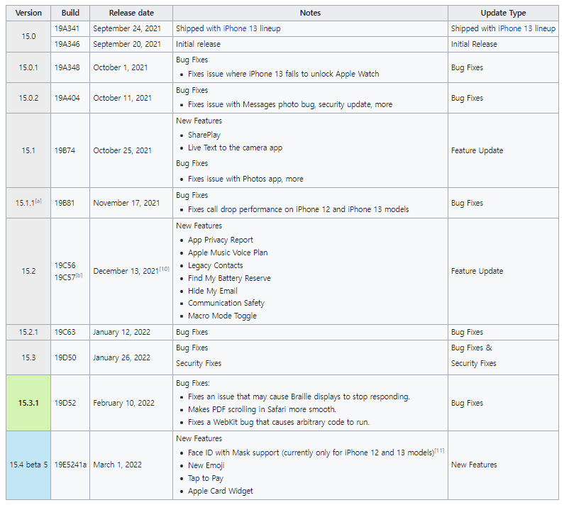
iOS 15
2021 - 2022
(Xcode 13, Swift 5.5)

Slide 24

Xcode
애플의 통합 개발 환경
Integrated development environment (IDE)
iPhone, iPad, Apple Watch, Apple TV, Mac
creating your app to testing, optimizing, and submitting it to the App Store

Slide 25
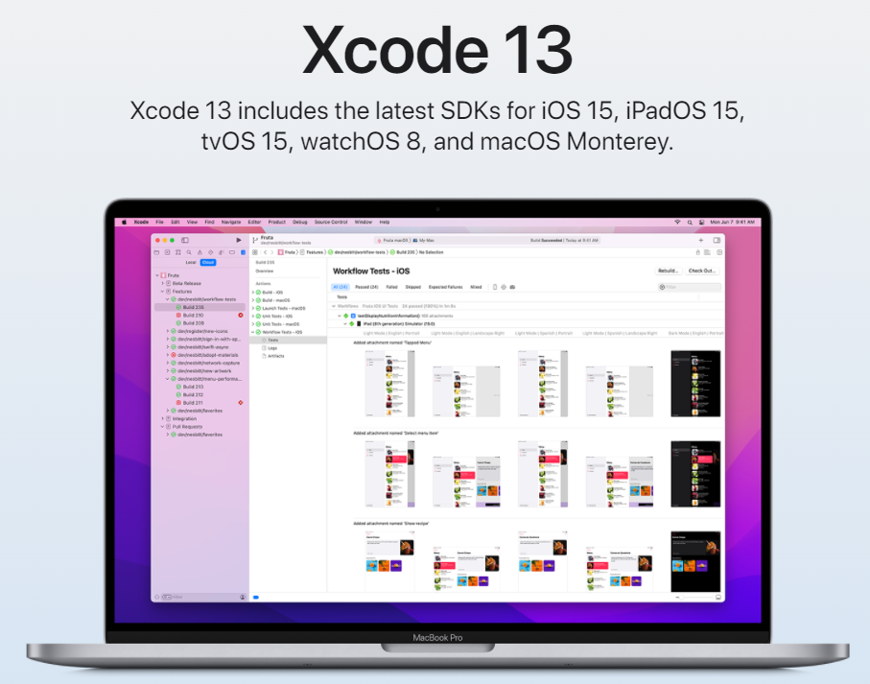

Slide 26
Swift
C와 Objective C의 결합
to make programming easier, more flexible, and more fun
#include <stdio.h>
int main(void){
printf(“Hello World);
return 0;
}
print(“Hello World”)

Slide 27
Swift
오픈소스 프로젝트 운영
공식홈페이지: https://swift.org

Slide 28
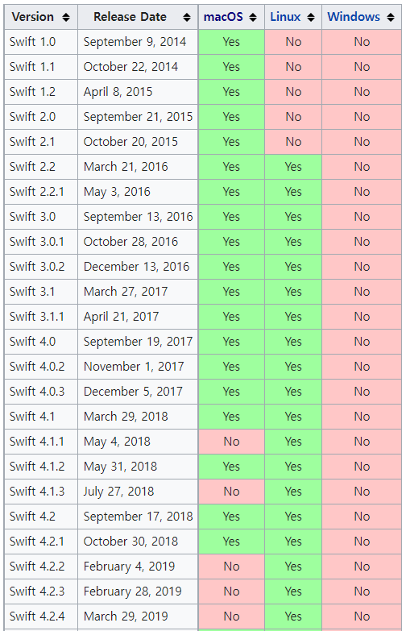
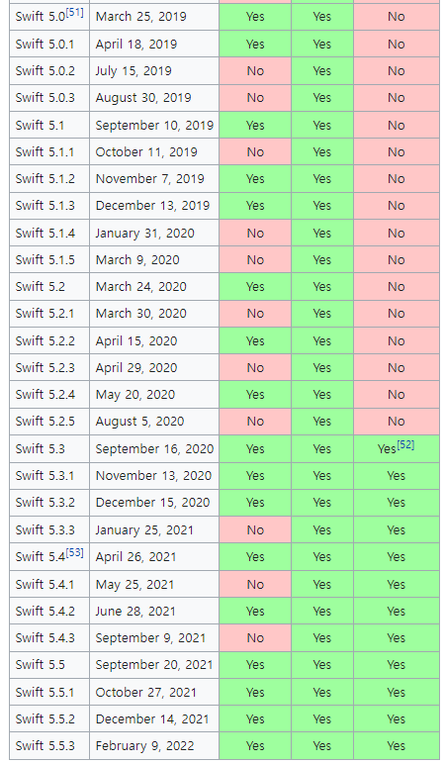
Swift
오픈소스 프로젝트 운영
공식홈페이지: https://swift.org

Slide 29
Question?

